Slide 1
GREEN BUILDINGS, SOLAR VOLTAICS: Assessing Energy Efficiency and Cost Effectiveness towards LEED Certification in St. Kitts and Nevis
Presenter: Mr. Kenrod Roberts

Slide 2
Presentation Objectives:
Discuss the aims and objectives of Green Buildings
Highlight the Various Aspects of LEED Certification
Assess and Evaluate Energy Efficiency and Cost Effectiveness as it relates to Green Buildings
Provide a Road Map for the Implementation of Practical Green Building strategies towards LEED Certification in St. Kitts and Nevis. (Includes a Case Study Review)

Slide 3
What is Green Building ?
Integrative Process That Focuses On The Relationship Between Built Environment And Natural Environment.
Why Green Buildings ?
Buildings can have both positive and negative impacts on their surroundings as well as the people who inhabit them everyday.

Slide 4
What are the aims of Green building?
Reduce energy and water use
Healthy environmental quality
Smart material selection
Reduce Building effects on its site
Notes:
Are key considerations for a green building
These buildings to do less harm and do more good which creates a more sustainable environment for all

Slide 5
So What is LEED?
Leadership in Energy and Environmental Design.
Is a Green Building Certification Programme.
Promotes better buildings, places a complement on the environment, better bright healthier spaces to live, work and play.
Decision making framework for project teams during the life cycle of a building which includes: Planning, Design, Construction and Operations.
Notes:
Leed looks to reward best practices and innovation and rewards exemplary performance with different levels of certification.
Is a Green Building Certification Programme that recognises Best in Class building strategies and practices across the globe.
Decision making framework for project teams during the life cycle of a building which includes: Planning, Design, Construction and Operations.

Slide 6
LEED Globally at a Glance
140+ Countries and territories
10.4 Billion Certified Commercial Sq Ft
It is administered by the USBC (US Green Building Council)
Notes:
A quick search for LEED Certification Companies and Suppliers serving St. Kitts reveals a list of options based mainly in the US.

Slide 7
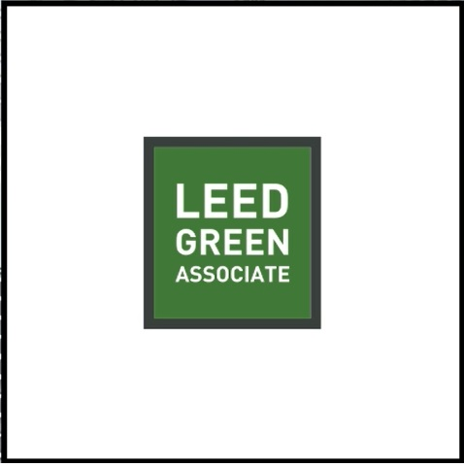
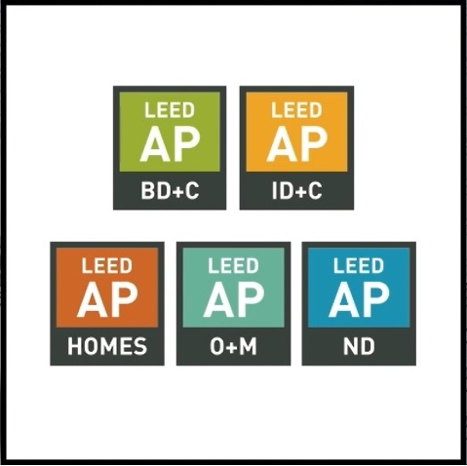
Achieving LEED Certification
Projects pursue credits that earn points
- Prerequisites and credits differ for each rating system.
Qualifications for Professionals
Notes:
In a nutshell Leed is about Saving money, conserving energy, making better material choices.
By honouring the interconnections the building can be built and operated in a more sustainable and efficient way. For example by considering insulation materials and daylighting, buildings manager can use less energy in heating and cooling their buildings. By bringing architects, engineers, designers, material speciaist and others to the table during the design phase decisionc can be made that position building for excellence in operational performance.
Two types of credentials
- Leed Green Associate (Your Gateway to going green. Gives you a foundational up-to-date understanding of curent green building principles and best practices)
- Leed AP with Specialty Credentials (The next level, equiping you with indepth technical knowledge as well as expertise in a specific Leed rating system.)

Slide 8
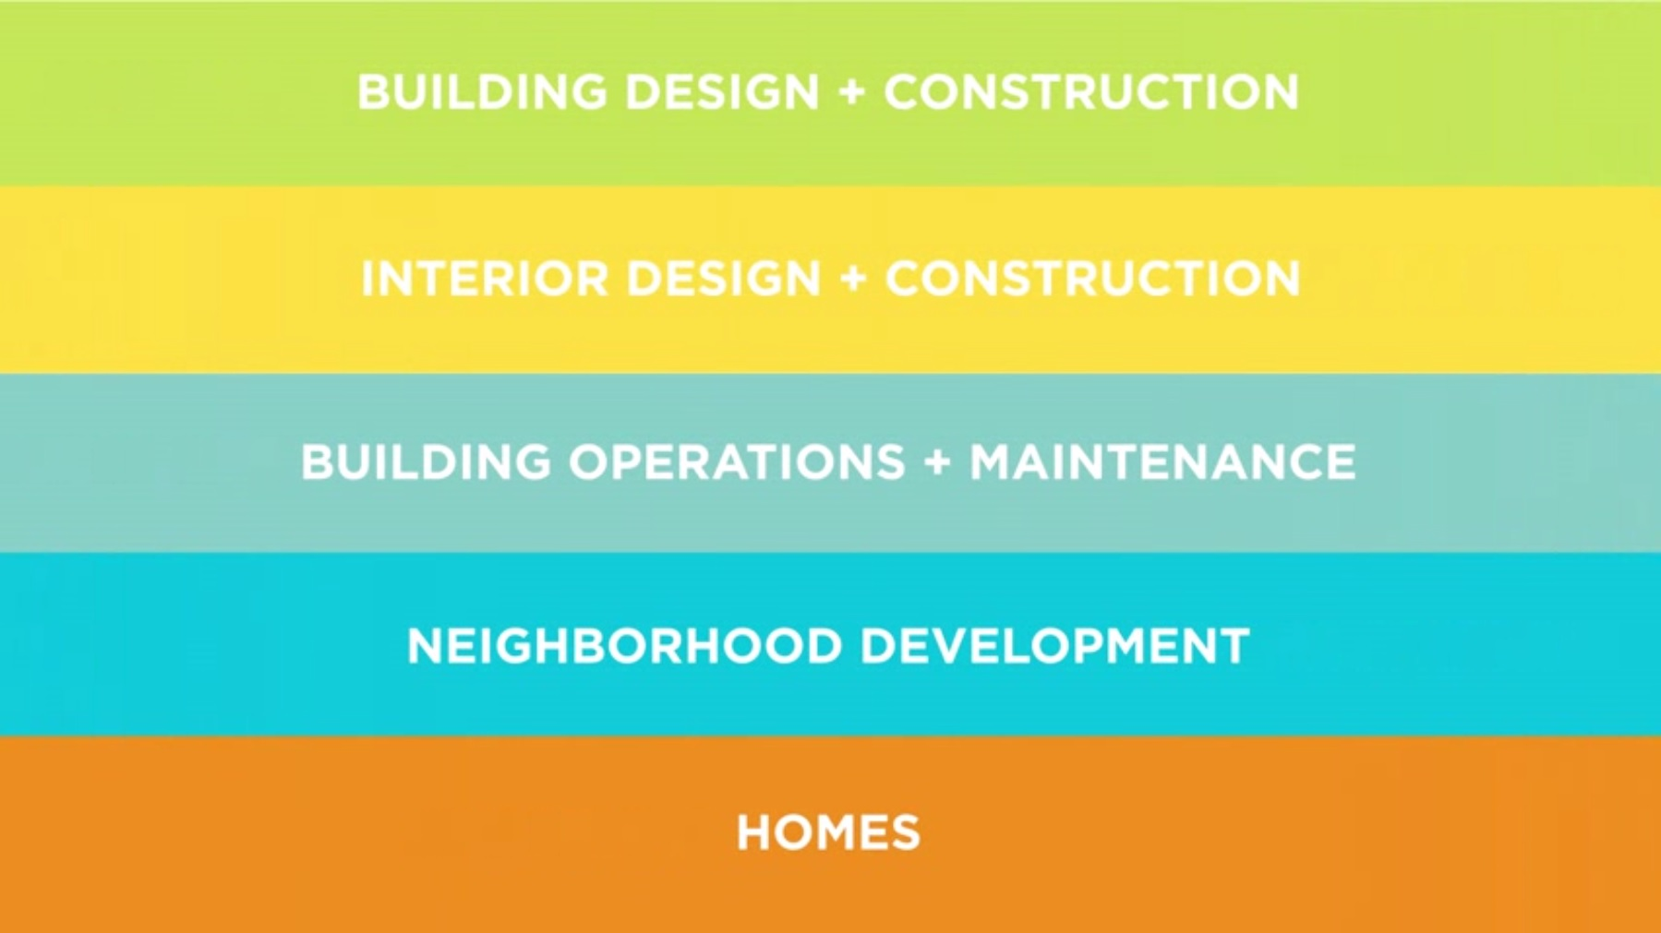
LEED CERTIFICATION RATING SYSTEMS

Slide 9
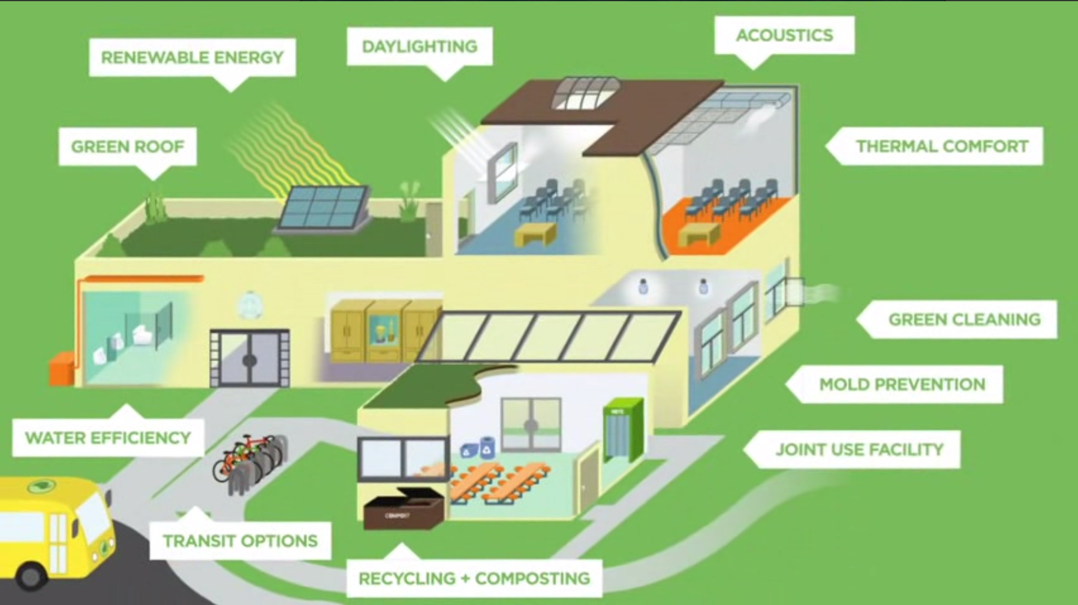
Illustration of Green Building Practices

Slide 10
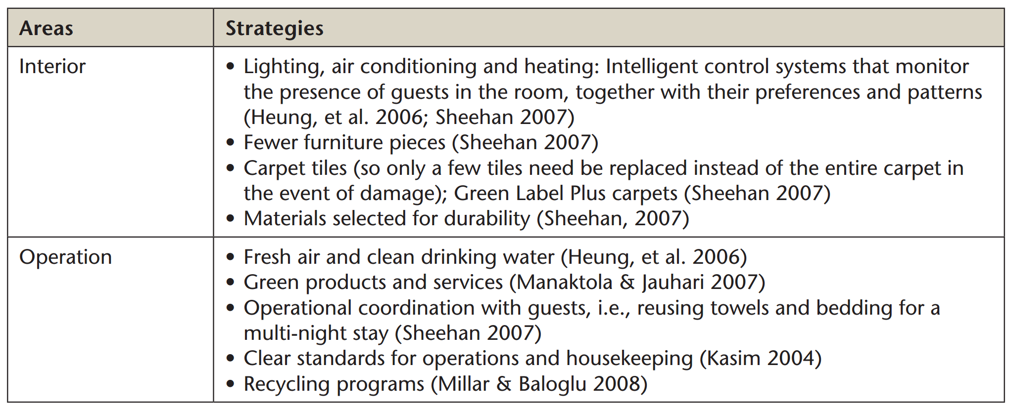
Specific Strategies for Hotel

Slide 11
CASE STUDY: PROXIMITY HOTEL
The Proximity Hotel, a 147-room hotel that includes a restaurant and 5,000 square feet of conference, meeting, and event facilities, opened in early November 2007
To achieve their goals of green building, luxury and long-term economic viability, the project team implemented over seventy green building practices

Slide 12
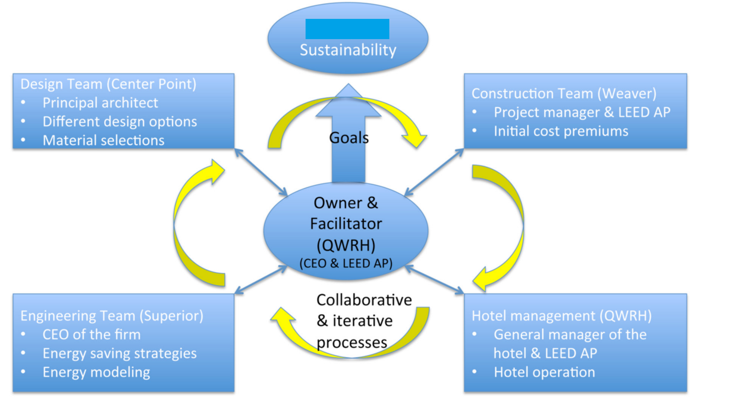
STRATEGIES TOWARDS LEED CERTIFICATION

Slide 13
Strategies to Attaining Green Building Certification
Site Strategies
Water-Related Strategies
Energy-Related Strategies
Materials-Related Strategies

Slide 14
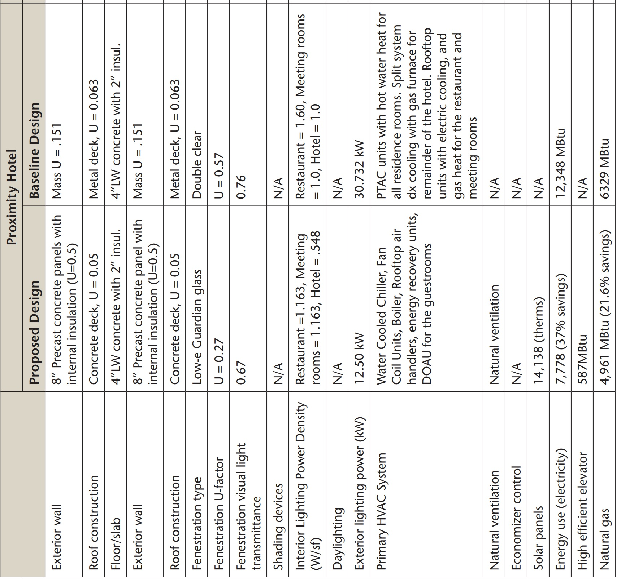
Sustainability Practices in Case Studies

Slide 15
Sustainability Practices in Case Studies

Slide 16
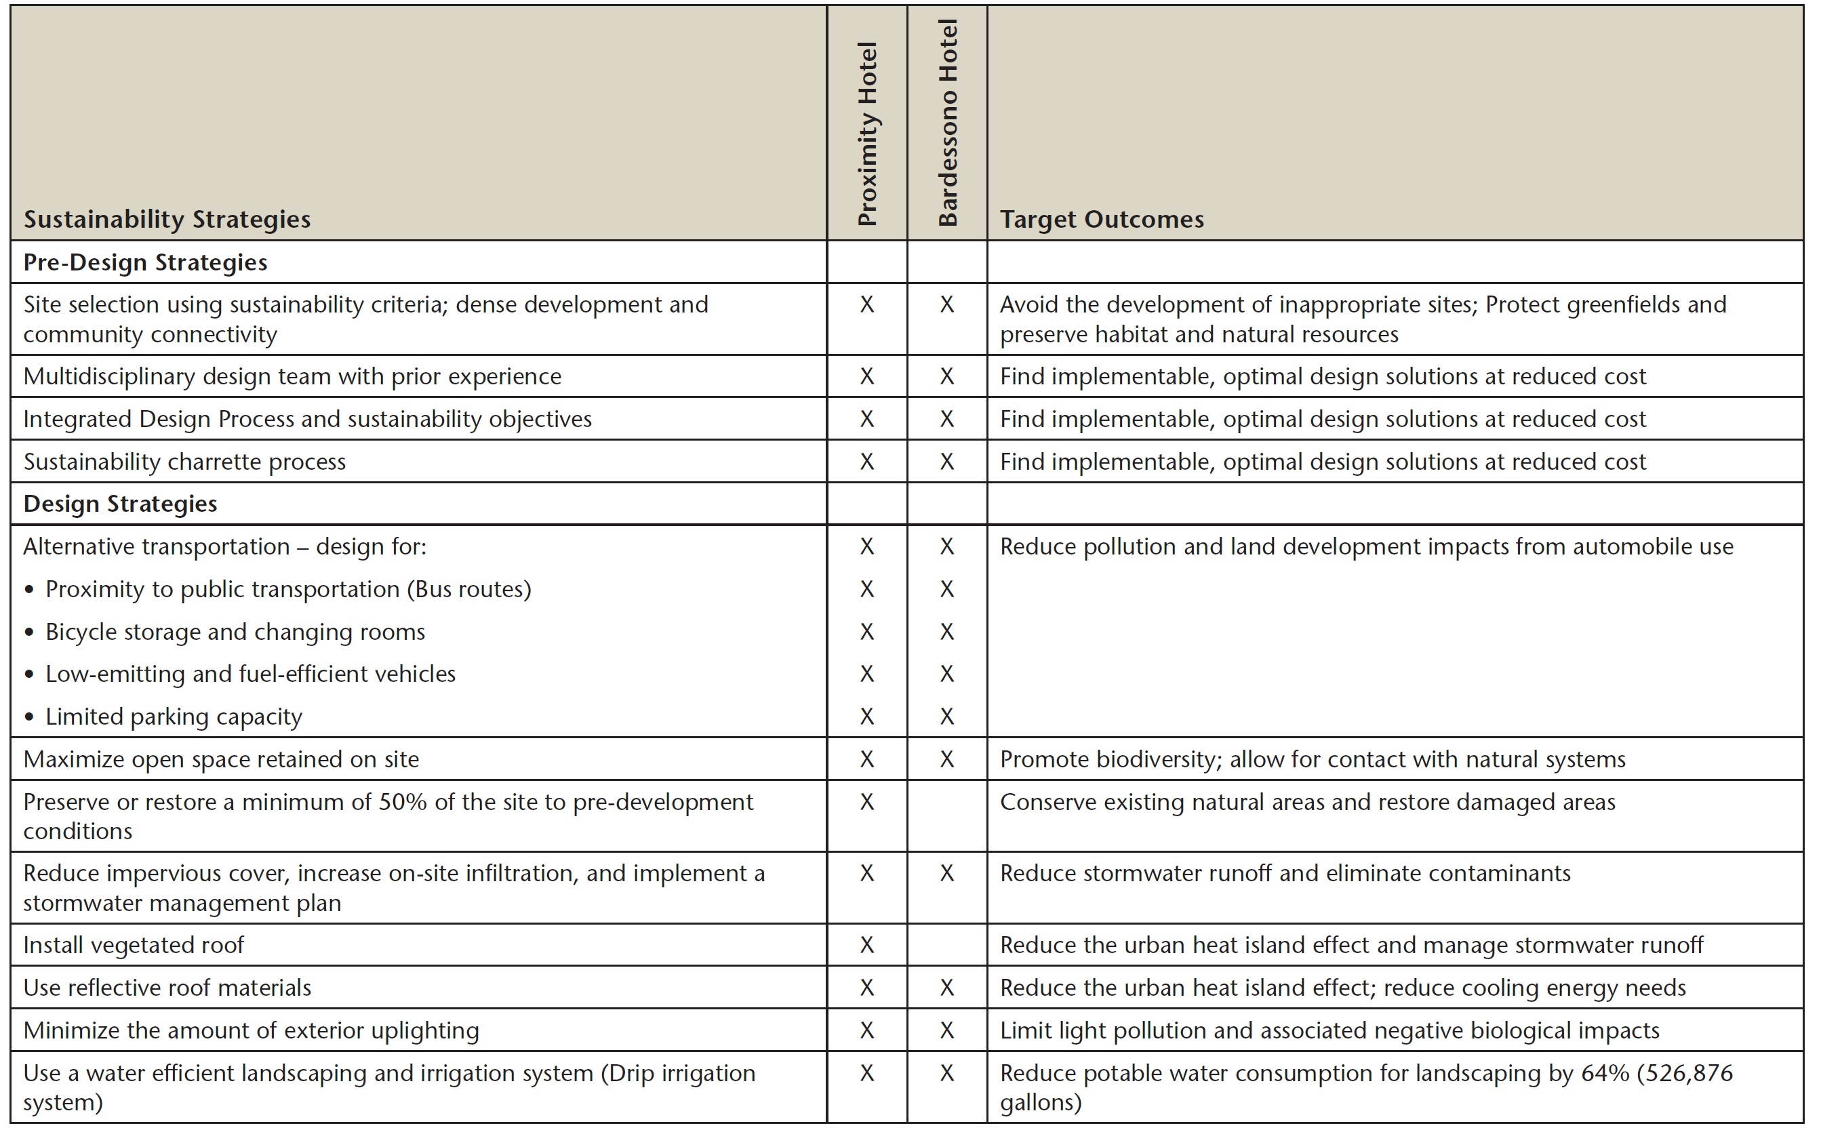
Sustainability Practices in Case Studies

Slide 17
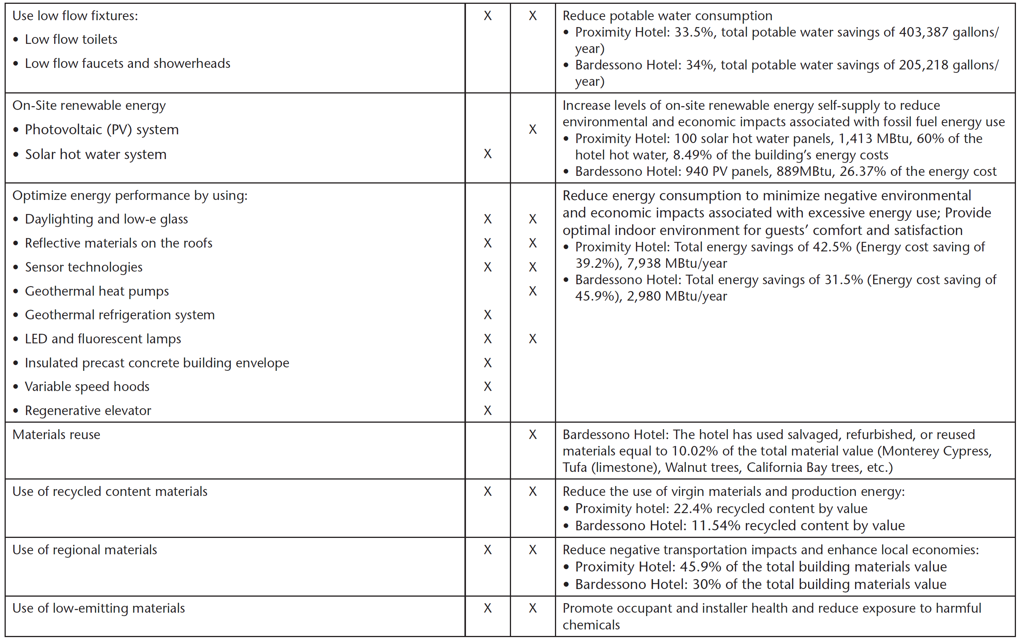
Sustainability Practices in Case Studies

Slide 18
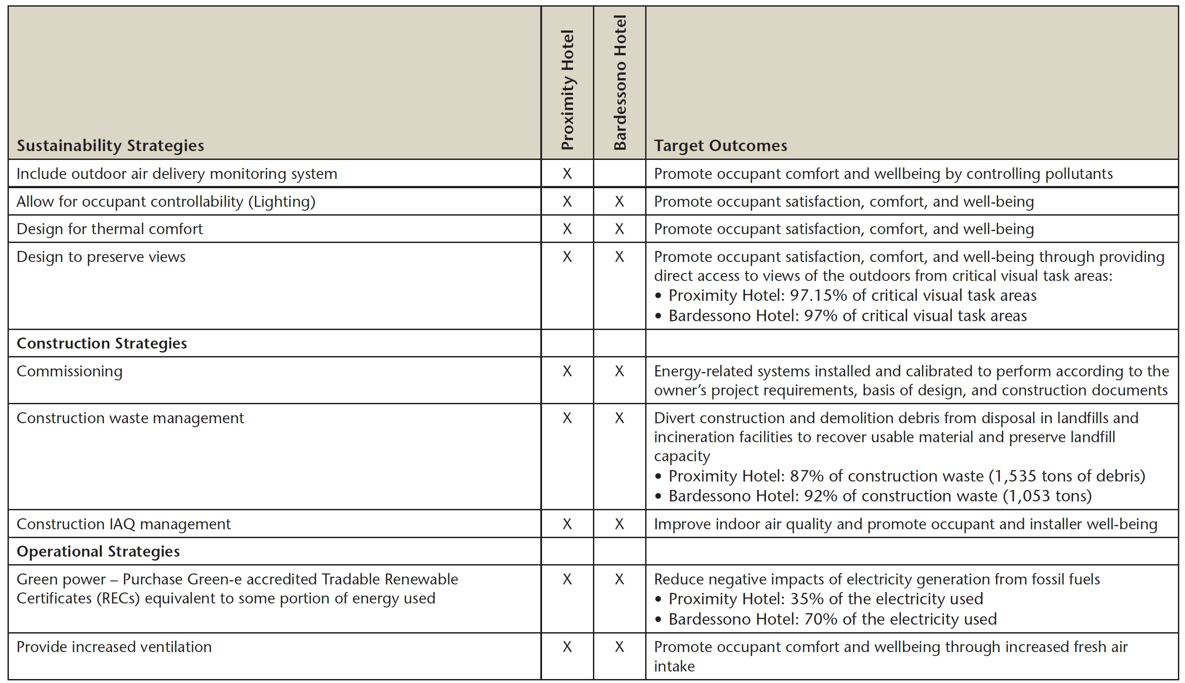
Sustainability Practices in Case Studies

Slide 19
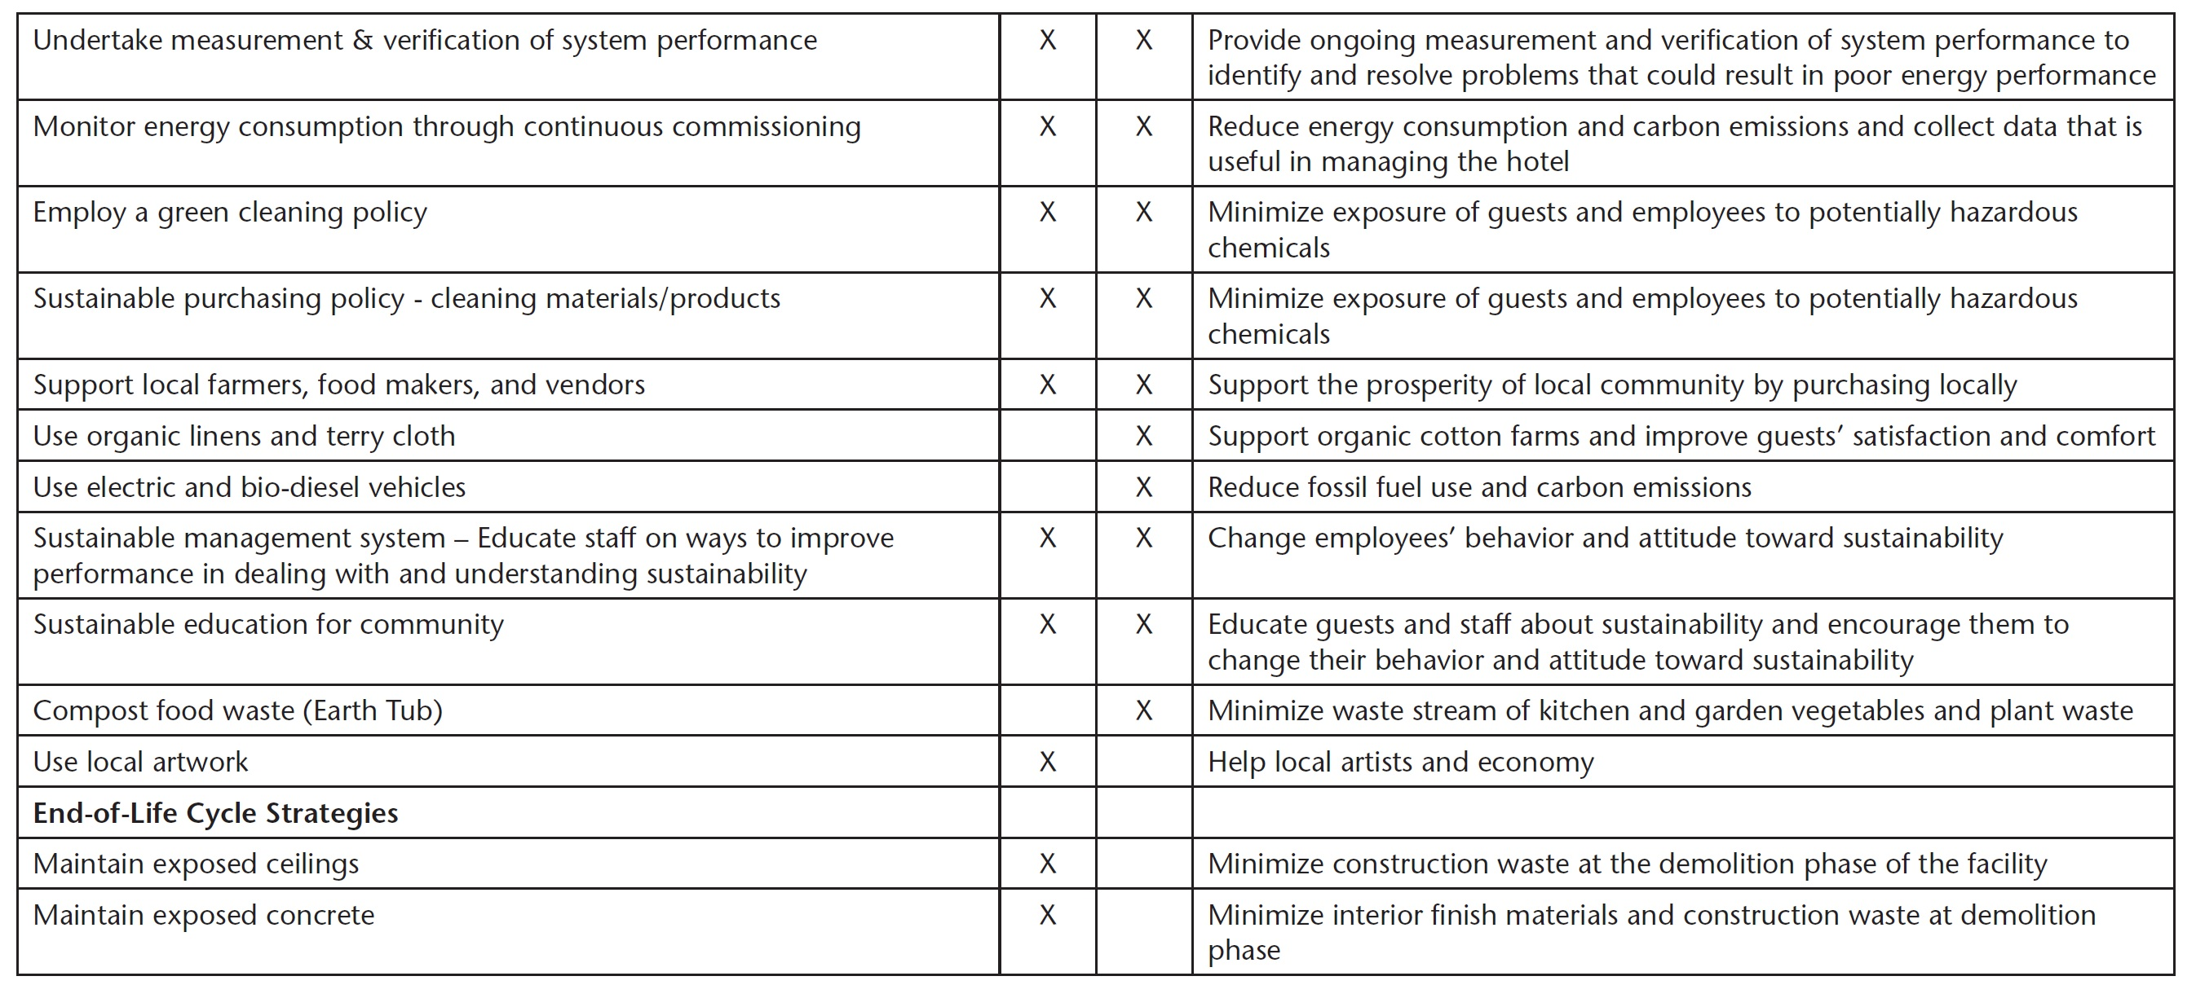
Sustainability Practices in Case Studies

Slide 20
Moving St. Kitts and Nevis Towards LEED Certification
Training and Certification of Architects, Contractors and Interior Designers.
Update of Building Codes to Encourage Use of Green Energy Practices.
Proper Cost Modelling of Strategies to be Implemented. Cost Effective = (Cost savings over life cycle of building)
Integrative Approach

Slide 21
Conclusion
Pathway to LEED Certification
Increase awareness of Green Building Strategies
Training of Professional and Certification
Establishment of a Green Building Council as has been done in various parts of the world.
Updating of Building Codes to Take Encourage Adoption of Green Building Practices. (Eg. Increase Rain Water Harvesting)
Wholistic Approach to the Design and Construction of Buildings with Assessment done over the Lifetime of a Building.

